Slide 1
Containers
Enterprise Cyber Security Engineering & Integration team (ECSEI)
Contributed by:
Jatinder
Yun
Shubham
Isha
Date: April 2025

Slide 2
Table of Content
Introduction to Containers
Benefits of Containers
Key Container Technologies
Docker
Kubernetes(K8)
Containers Security
Testing the code

Slide 3
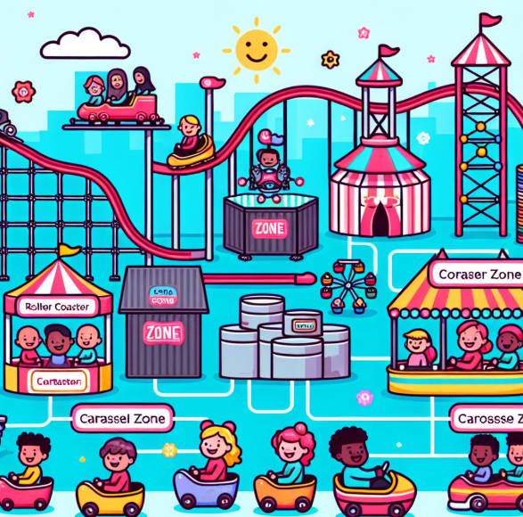
Introduction to Containers
A lightweight, standalone and executable S/W Package
Includes everything to run an application(Code, System tools, System Libraries and Settings)
Notes:
A container is a light-weight, standalone, s/w executable package which includes everything to run an application like code, libraries, system tools and configuration files etc. We can image this theme park where we have multiple rides and consider each ride as container which has everything it needs to operate e.g., ride itself, safety equipments and instructions

Slide 4
Brief History and Evolution
VM 1
VM 2
C1
C2
Application
Application
Application
Application
Lib/Bin
Lib/Bin
Lib/Bin
Lib/Bin
Guest OS
(Windows)
Guest OS
(Linux)
App 1
Hypervisor
Container Engine
Host Operating System
Host Operating System
Host Operating System
Hardware
Hardware
Hardware
Traditional Deployment
Virtualized Deployment
Container Deployment
Notes:
Traditional deployment – involves building an application a specific OS, hardware and N/w
Virtualized Deployment – More enhancements and improvements as compared to traditional deployment.
Hypervisor is a software which enables the creation and management virtual machine on a single serve.
Containers are light weight , faster to start up and consumes less memory.

Slide 5
Benefits of Containers
Portability : Ability to run applications across different environment without any modification e.g. developer’s laptop, test environment or production environment
Efficiency : Container uses fewer resources as compared to virtual machine. They share host OS kernel which means they startup faster and uses less memory and storage
Scalability : Ability of an application to handle growing workloads. Distribute the load using Horizontal scaling
Isolation : Each container operates independently ensuring vulnerability in one container does not affect other container

Slide 6
Key Container Technologies
Docker
Kubernetes(K8s)

Slide 7
Docker
What is Docker?
A platform that allows developers to create, deploy and run applications in containers
How Docker Works?
Docker Containers
Docker Engine
Docker Hub
C1
C2
Application
Application
Lib/Bin
Lib/Bin
Docker Engine
Host Operating System
Hardware
Notes:
How Docker Works:
Containers: These are the special boxes that hold everything a program needs. They make sure the program runs the same way no matter where it is.
Docker Engine: Core part of docker that handles the creation and management of containers. It specifies how the application can interact with the Server and instructs it what to do.
Docker Hub: Think of this as a library where you can find and share containers. You can look up containers that other people have made and use them for your own programs.

Slide 8
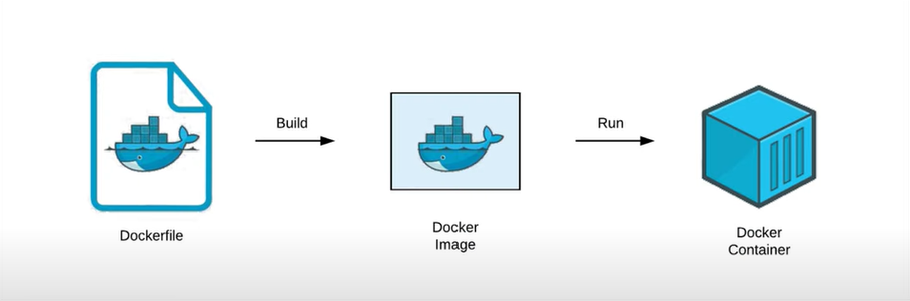
Docker Lifecycle
Notes:
Docker is the building block, it packages and run the applications in isolated environments known as containers.
Docker file is a text file that describes how to build a container it defines the base image like python or node js , install dependencies, copy files and set commands for the containers to run.
Docker image is the result of Docker file , image containers everything it needs to run an app including code, libraries, system tool etc
Docker container is a running instance of docker image. Think of it as isolated process that can be run anywhere on any system that supports docker. Docker allows developers to create a consistent environment for their apps. You can ensure your code runs the same way in development, staging and prod

Slide 9
Kubernetes
Open-source container orchestration platform originally developed by Google
Helps in automating deployment, managing containerized application
Helping in Scaling the load
Uses Master-Slave Architecture

Slide 10
Hierarchy of K8s structure
Cluster
Node
Node
Pod
Pod
Container
Container
Container
Container
Pod
Pod
Container
Container

Slide 11
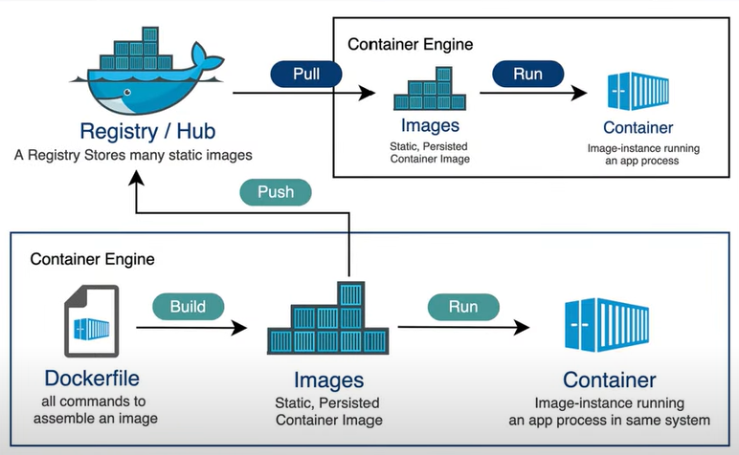
Workflow of Docker and Kubernetes
Notes:
Developer uses docker to package application in containers including all dependencies. The docker image is pushed the container registry(Docker hub etc).
Kubernetes pulls the image and deploy it as a pod then K8s will monitor the traffic and scale the pod horizontally adding more containers as needed.
It also ensure the incoming traffic is routed to healthy containers. If any container crashes Kubernetes will automatically restart the container to ensure the desired number of replicas are running.

Slide 12
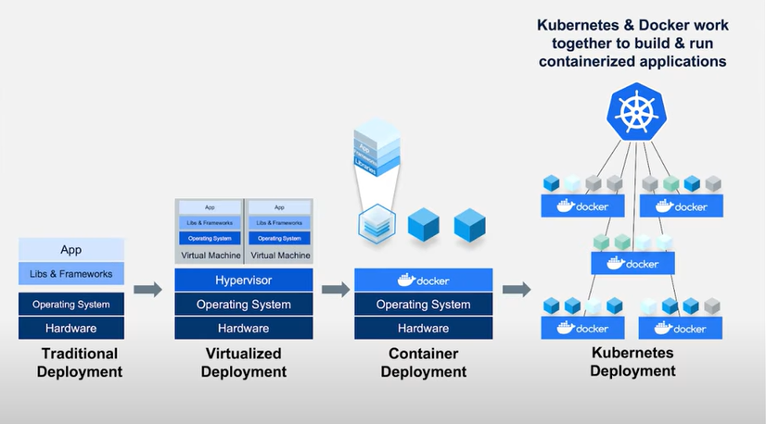
Different Deployment Architectures

Slide 13
Container Attack Surfaces
Surface Attacks | Solutions
Images | Up-to-date images, Image Scanning and Sign the image
Registry | Private registry, Monitor vulnerability, Host server is secure
Container Runtime | App security is up-to-date, monitoring network protocols and network payload and monitor Host
Orchestration platform | Access control for users, monitor orchestration and monitoring pod communication
Host OS | Access control with OS and monitor OS
Notes:
Up-to-date, Scanning, Sign the image-
Private, Monitor for vulnerability, host server is secure
Runtime security which we use to execute our containers: App security, monitor Network protocols
Orchestrator: which manages the lifecycle of multiple contauner; Limit, Pod ccommunication
Host Os:which manges docker client and docker deamon Access control, monitoring

Slide 14

Questions?

Slide 15
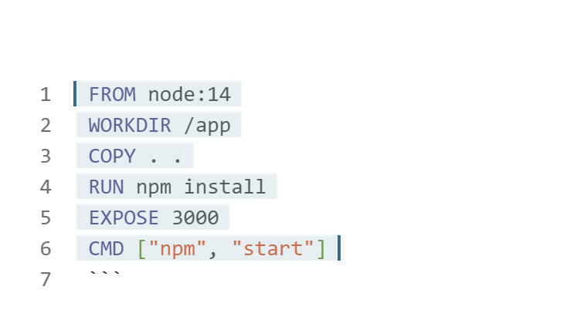
DockerFile

Slide 16
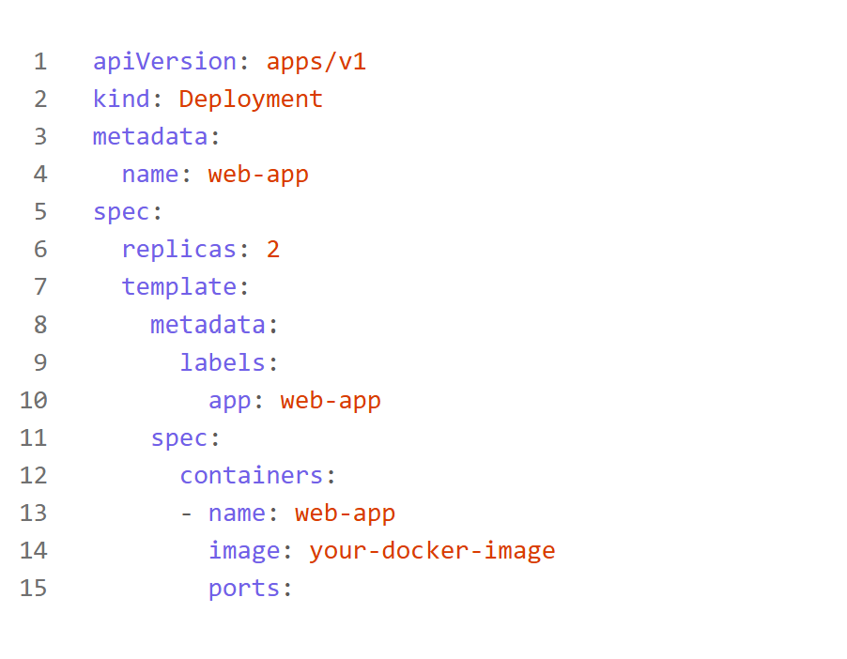
Kubernetes Deployment file

Slide 17
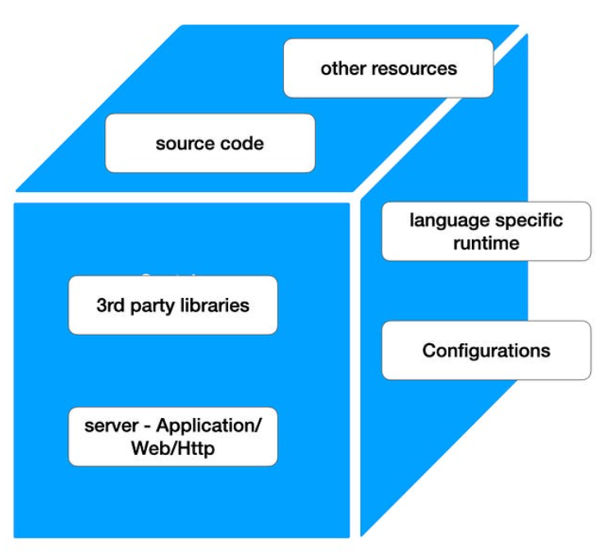
Container
A container is an application that been packaged with all the files, configurations and dependencies necessary for it to run. It allows users to create independent and isolated environments to launch and deploy its applications.

Slide 18
Types of Containers
Application Containers: These are the primary containers running the application logic.
Init Containers: These containers run during Pod startup to perform tasks like setting up the environment or downloading dependencies.
Sidecar Containers: These containers run alongside the main application container to provide auxiliary services, such as logging, data synchronization, or proxying.
Ephemeral Containers: These containers can be injected into a running Pod for debugging purposes.

Slide 19
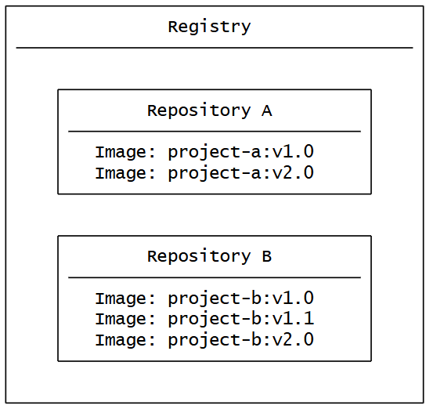
Registry
A registry is a centralized location that stores and manages container image whereas a repository is a collection of related container image within a registry.

Slide 20
Container Security
Increased Attack Surface
Expanded number of potential entry points for cyberattacks
Open-Source Components
Build using open-source components, which can introduce Vulnerabilities if not properly managed
Inter-Container Communication
Containers interact with the host system and other containers
Privilege Escalation
If a container runs with more privileges than it needs, it can expose the underlying system to security risks, such as unauthorized access or control
Data Protection
Containers can store sensitive data
Compliance
Container security must address regulatory and industry compliance requirements
Notes:
The expanded number of potential entry points for cyberattacks due to the nature of containerized environments like Shared Kernel, Open-Source Components, Inter-Container Communication, Dynamic Nature

Slide 21
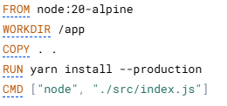
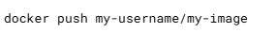
Steps to create a container
Step 1: Building images : A Dockerfile is a text-based document that uses to create a container image. It provides instructions to the image builder on the commands to run, files to copy, startup command and more.
Step 2: Tagging images : Tagging images is the method to provide an image with a memorable name, which also determines where the image can be distributed.
Step 3: Publishing images: Once you have an image built and tagged, you’re ready to push it to a registry.

Slide 22
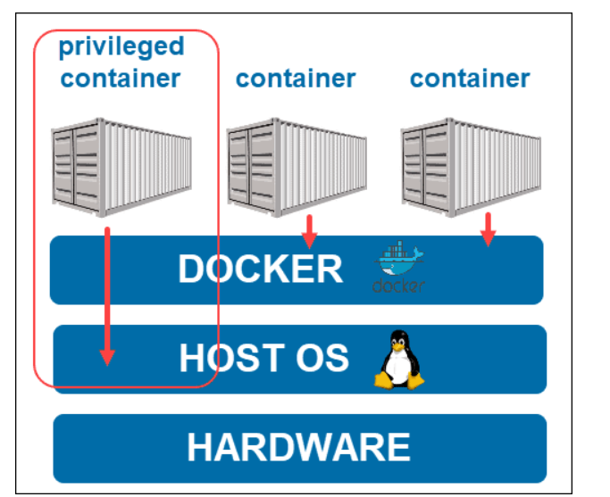
Privilege and Un-privilege Container
Docker privileged mode grants a Docker container root capabilities to all devices on the host system. Running a container in privileged mode gives it the capabilities of its host machine.
Cons: Exposing the kernel and the hardware resources of the host to any outside cyberattack is always a potential threat to the system.
Precautions: User namespace remapping, re-mapping the user for that specific container to a less-privileged user on the Docker host. Essentially, the container views the user as the root, while the host does not.
Re-mapping includes assigning a range of UIDs that function within the container (namespace) as normal UIDs from 0 to 65536 yet have no privileges on the host. Two files manage the user configuration – one for the user ID range (/etc/subuid) and the other for the group ID range (/etc/subgid).
By default, docker uses the dockermap user and group to make the remapping.

Slide 23
Containers Security Considerations
Isolation and Segmentation
Image Integrity
Resource Management
Access Control
Notes:
Isolation and Segmentation: Imagine each ride in the theme park as a Docker container. If one ride has a malfunction, you wouldn't want it to affect the others. Similarly, Docker containers need isolation to prevent vulnerabilities in one container from impacting others or the host system
Image Integrity: Image integrity in container security refers to ensuring that container images are authentic, untampered, and free from vulnerabilities. Image scanning and signature verification help maintain the integrity of the images, ensuring that the rides operate safely and as intended
Resource Management: Each ride in the theme park requires a certain amount of power and resources to operate. Similarly, containers can consume significant resources, and without proper management, they can lead to denial-of-service attacks. Using control groups (cgroups) helps manage and limit resource usage
Access Control: Just as you control who can access certain areas of the theme park, robust access control mechanisms prevent unauthorized access to containers, protecting sensitive data and ensuring that only authorized personnel can make changes

Slide 24
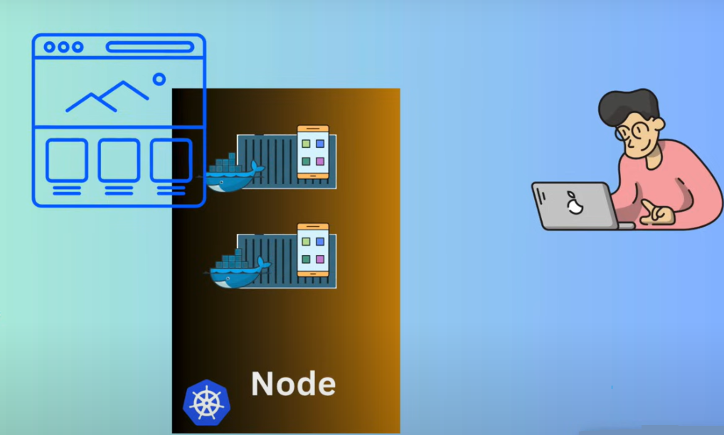
Server

Slide 25
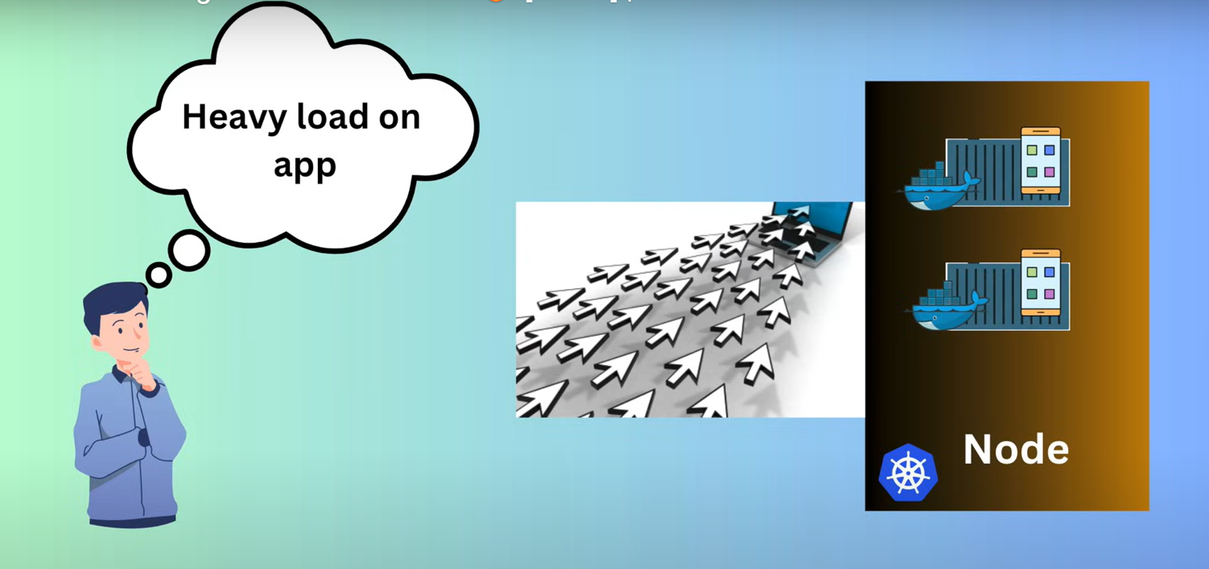
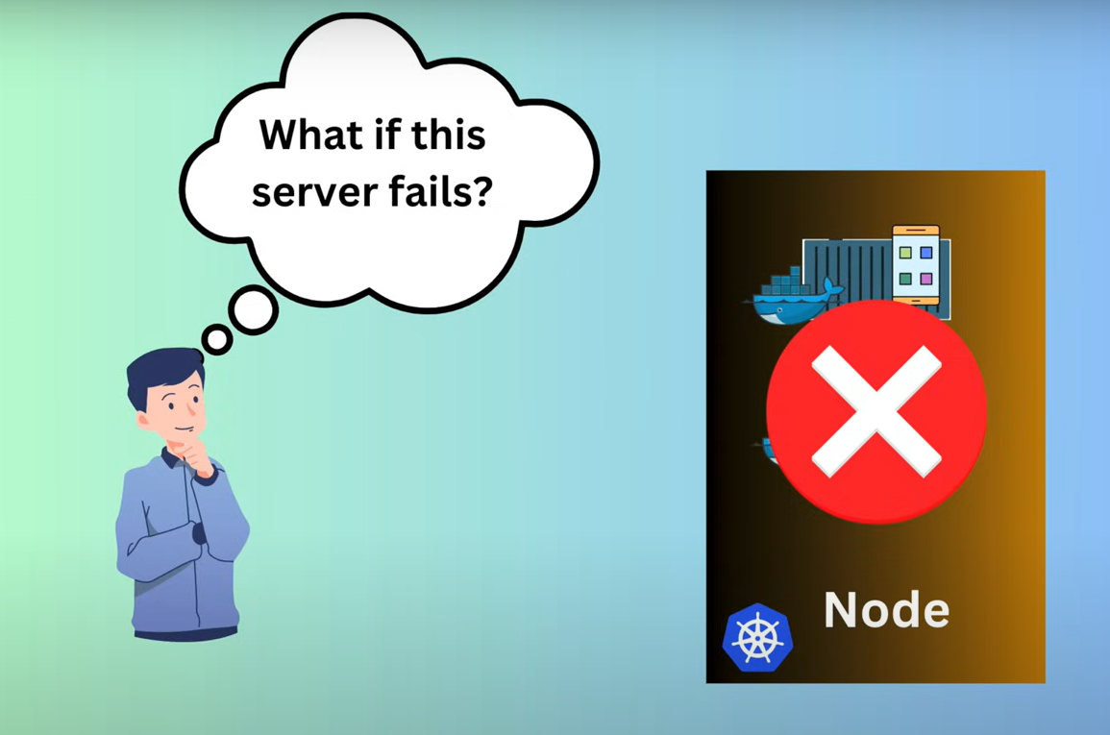
Problems :

Slide 26
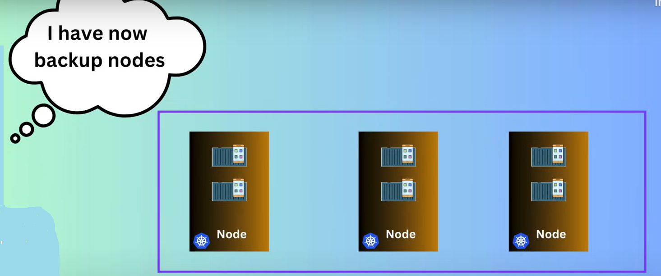

Slide 27
Hierarchy of K8s structure
Cluster
Node
Node
Pod
Pod
Container
Container
Container
Container
Pod
Pod
Container
Container

Slide 28
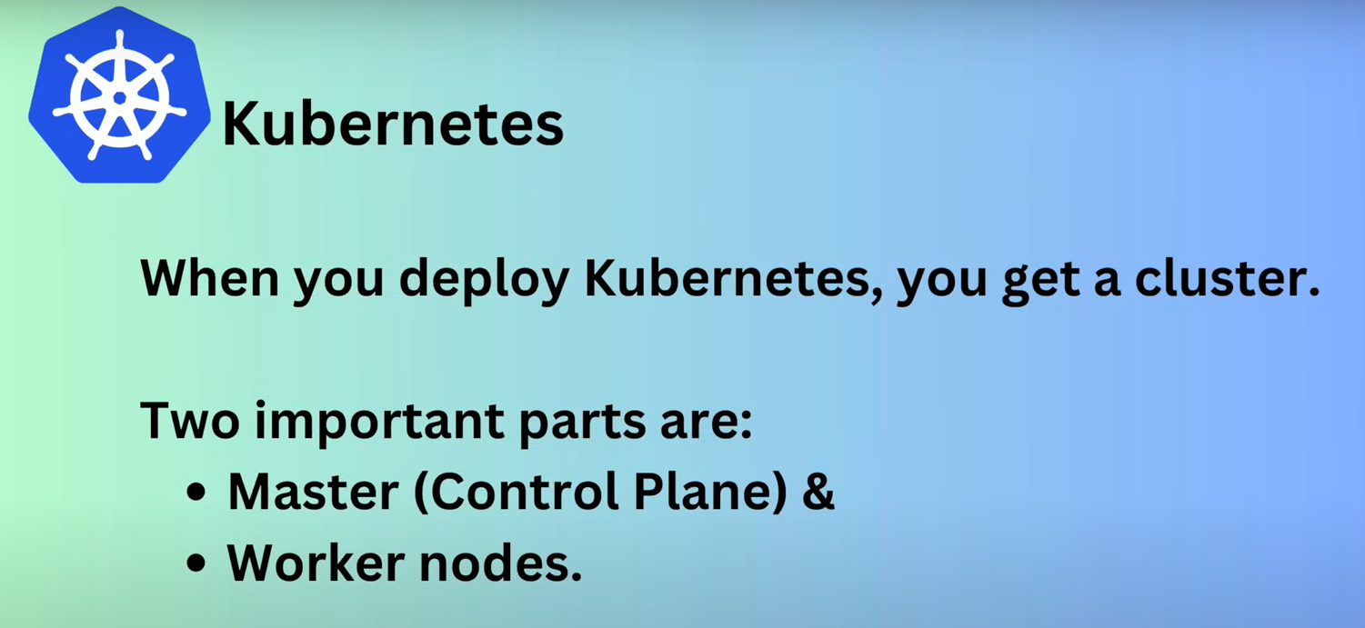

Slide 29
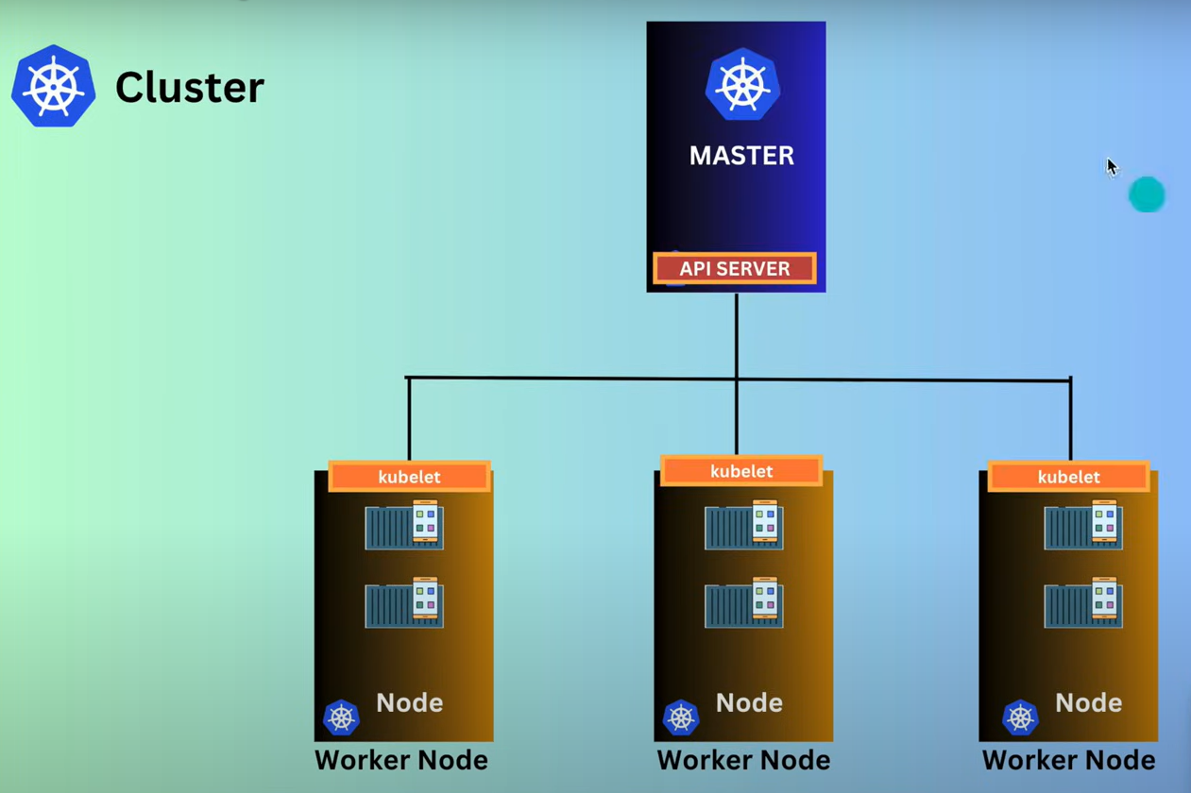
Notes:
The API server in Kubernetes is a crucial component of the control plane

Slide 30
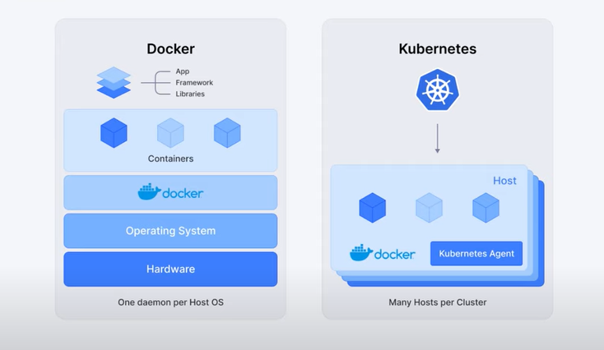
Docker Vs Kubernetes
Notes:
Docker Run the container and K8s handle the orchestration like deploying, scaling and managing hundreds or thousands of container across multiple servers. It is ultimate tool for running complex and distributed applications

Slide 31
Container Security Components
Container security architecture is designed to protect containers throughout their lifecycle.
Container engine security
Container images security
Registry security
Orchestrators security
Notes:
Container engine security: Container engine security focuses on the underlying runtime system that manages and executes containers, such as Docker. These container engines are responsible for interfacing with the operating system kernel to provide the isolated environments that containers run within.
Container image security: Like runtime environments, container images should only be sourced from trusted providers. It’s important to keep your container images up to date with security patches and updates. Regularly updating and patching container images ensures that their attack surface is minimized by removing any unnecessary packages and dependencies.
Registry security : Think of encryption as the secure communication channels b/w the control room and the rides. Ensuring data in transit and at rest is encrypted which protects the image from being intercepted or tempered with during transfer and storage.
Orchestrators security: Orchestration security refers to the measures taken to protect container orchestration systems, such as Kubernetes, from potential threats and vulnerabilities. E.g. up-to-date system running version, IAM(Identity access management through roles and premissions), Least-priviledge access model

